Slide 1
Advising
By Crystal Couch

Slide 2
NACADA​
The Global Community For Academic Advising ​
NACADA: An association of professional advisors, counselors, faculty, administrators, and students working to enhance the educational development of students (NACADA, 2022).

Slide 3
NACADA Advising Competencies
Conceptual: Provides context for the delivery of academic advising - think of this as the foundation of the theories and ideas that provide an advisor with their foundation (NACADA, 2017).
Informational: provides substance - the knowledge of an institution or program that help an advisor guide students (NACADA, 2017)
Relational: provides skills that enable advisors to convey concepts and information to students (NACADA, 2017).

Slide 4
NACADA: Core Values of Academic Advising Image: NACADA, 2017

Slide 5
Advising Approaches
Proactive – Intrusive Advising

Slide 6
Proactive Intrusive Advising
Intrusive Advising Concept introduced by Earl (1988):
Action – Oriented response
Deliberate intervention that identifies a problem
Aims to motivate a student to seek out help
Varney (2012):
Utilize strategies that show interest and involvement in students
Work to educate students on options
Approach students before a situations develops
Notes:
Focus on reaching out and meeting with student prior to a situation happening – i.e anticipating an issue and addressing it before it occurs
Beneficial especially with a student who exhibits patterns or a need for support
Although there is a fine line between assuming a student will have a problem and allowing the student to open up and express, they need support
Deliberate strategies that show interest in students and working to education students on their options

Slide 7
Proactive Intrusive Advising
Four Stages of Student Development Earl (1988):
1: Early warning Signs
2: Action – Oriented Responses
3: Emphasis on action wide participation
4: Retention is a concern about professional staffing
Notes:
Four Developmental Stages – in regard to old dominion university
1. early warning signs
2. Action – oriented responses
3. Emphasis on action wide participation
4. Retention is a concern about professional staffing

Slide 8
Advising Approaches
Developmental Advising

Slide 9
Developmental Advising
One to one interaction with a student who “is motivated to seek assistance” (Earl, 1998, p.29).
Focus on identifying & accomplishing students life goals, skills & attitudes to promote growth, sharing concerns (McGill, 2016, pg. 51).
McGill (2016) - Three major themes to Developmental academic advising:
Assessment of student's competencies and readiness
Discuss the importance personal campus involvement
Aid in helping them to develop a life purpose and plan
Notes:
Focus on the overall development of students
Identifying their goals and creating plans to achieve those goals
What support do they need to further develop and plan
Explorational: exploration of life goals, vocational goals, program choices
Facilitating the students' rational processes, environmental and interpersonal interactions, behavioral awareness and problem-solving, decision- making, and evaluation skills

Slide 10
Advising Approaches
Strength's- Based Advising

Slide 11
Strengths – Based Advising
Key point of strengths – based advising: “ valuing our students' lived experiences, skills, and talents” (Wagner, , p.35)
Schreiner’s (2013) Strength- Based Paradigm
1. Identify
2. Affirming
3. Envisioning
4. Planning
5. Application
Notes:
Identify a student's strength by building a positive relationship, explore lived experiences background and successes
Affirming increasing a student's own awareness with skills and abilities they posses
Discuss aspirations and articulate the connection between strengths and goals
Planning – goal setting and how to achieve those goals
Applying students' strengths to situations and challenges
Promotes student achievement and assumes that when students are more aware of their strengths, they will be motivated to set goals achieve at a higher level, make positive choices, and complete the tasks they set out to achieve (Schreiner and Anderson, 2005)

Slide 12
Case Study: Student #1 – Layla
Layla is a second-year student who has expressed interest in the VIH program. She wants to apply to the program but does not know if it is right for her. Layla is a biology major and has thought about studying abroad but never thought she would have time to do so. She is also not sure how a study abroad experience would help her find a job after graduation. She reaches out to you to learn more about the program and gain a better sense of whether the program is for her.
How would you advise Layla?
Notes:
Developmental Advising

Slide 13
Case Study: Student #2 – Dakota
Dakota has recently interviewed to be a part of the VIH program. During the interview, Dakota expressed that they are unsure of what program they want to go on. When they went to go look at possible programs, they became overwhelmed and anxious. Dakota is worried that they will make the wrong choice.
How would you help Dakota in this situation?
Notes:
Proactive – Intrusive Advising

Slide 14
Case Study: Student #3 – Jess
After attending the Fall Leadership Conference, Jess is concerned with how she will work with her CEE group. She expresses to you in an email that she is worried about the groups teamwork as she has not heard a response from the other team members in a while. As a result, she begins to feel stressed about the outcome of the groups CEE Event and does not know what she wants to achieve through the CEE.
How would you advise Jess through this situation?
Notes:
Strengths based advising

Slide 15
Case Study: Student #4 – Morgan
Morgan is a perspective applicant to the VIH program who has met with you on multiple occasions in preparation for interviews. Morgan has expressed to you that they want to go on a 6-week program to Spain that cost $10,958. After a quick conversation with them, you notice that Morgan would not qualify for supplementary funds from the program and is not a Pell Grant recipient. In order to set up Morgan for success you are considering presenting them with a budgeting plan, how would you advise Morgan through this situation?
Notes:
Strengths based advising

Slide 16
How Faculty Approach Advising
Notes:
Time Stamps:
0:36 – 2:14
4:45-7:47
After video plays debrief as a large group
- what are some key take aways?
What do we feel is still missing?
What are some points that we would want to add/share with the whole group?

Slide 17
Holistic Advising
Supporting Our Students

Slide 18
Holistic Student Support
Intentional planning and integration of critical student academic and personal support (Achieving the Dream, 2022).
When advising students, it is important to look to an "intentional Student-Centered" model (Achieving the Dream, 2022).

Slide 19
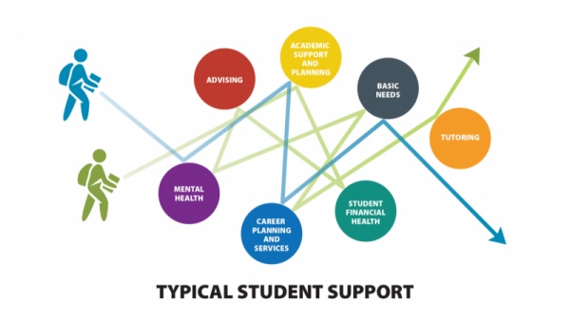
Notes:
What do we notice with in this photo?
Explain that we often find that students are receiving support that feels disconnect or oriented around one aspect of their college experience

Slide 20
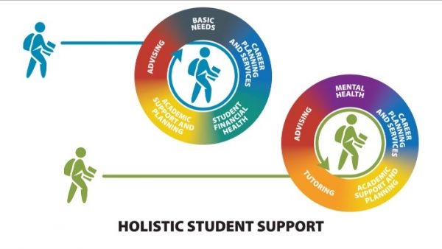
Notes:
In reality students' experiences are interconnected, and a student should they're for have support that encompasses and considers multiple aspects of their experience and wellbeing

Slide 21
Holistic Advising with VIH: Considerations
Student Centered & Care and Support
Challenge & Support
Focus on the whole student not just the VIH student
Language
Personal Reflection and Identification of Biases
Equity focus
Going to College in a COVID world
Notes:
Mention going to college in a covid world the experience of undergraduates now and much different than that of pass students
Challenge and Support: Sanford
Self- Authorship: Baxter – Magolda

Slide 22
Centering Our Students
Centering the needs of the students
Want to provide a students with a sense of support
we want students to feel as thought we will support them no matter the decision they make
Approach students through a holistic lens
Avoid the single story
Notes:
Single story Ted Talk: https://www.youtube.com/watch?v=D9Ihs241zeg
We do not want to make assumptions from our first meetings or what students choose to initially share
Centering the whole student
Mental and physical well being
Sense of belonging
Academcis
Creating trust
Basic needs

Slide 23
Language
Language is powerful and we want to make sure that we are using language that is empowering
Utilizing welcoming language
Reflect on how you are talking to students both consciously and subconsciously
Using a universal language vs, a deficit language
Allow students to open up to you rather then you assuming
Notes:
What questions are we asking?
Deficit language vs university language
Are you asking students questions about challenges or deficits they vs general questions?
-what questions are you asking white students vs BIPOC/Students of Color? What questions are you asking your straight/cis gender students vs your LGBTQIA+ students?
Welcoming language
Do you have any questions vs what questions do you have?

Slide 24
Equity Focus
Take the time to reflect upon your own biases and Identities
Universal Language vs Deficit Language
Creating an equitable playing field
Having all students reflect upon how their identities may impact their global experience
Allow students to express their concerns – do not assume students will have these concerns
Notes:
In order to allow our students to reflect upon their own identities, we must in turn do the same
Do not shy away from race/ethnicity/ gender identity – it is important to have these conversations but at the pace in which students want to have
Connects with language
Understanding what systems and structures are in place that contribute to the continued oppression of student of color
Not all student who have similar identities will share the same concerns
Area of bias → what biases do you have that are making you draw these conclusions or assumptions

Slide 25
Critical Race Theory in Global Education
What is Critical Race Theory?
Pioneered by Kimberlé W. Crenshaw, Derrick Bell, Patricia Williams, Cheryl Harris, Richard Delgado, and Mari Matsuda (Elnaiem, 2021)
Focus on the institutions/ hierarchy's vs the individual action
Privilege and Oppression
Notes:
Explain CRT
Double check CRT
Rejecting the idea of colorblindness
We are not focusing on the actions or behaviors of an individual but instead that of the system and structure that perpetuates oppression
One does not exist without the other
More definitions
Race
Ethnicity
Sexual orientation
Gender
Privilege
Oppression

Slide 26
Critical Race Theory in Global Education
Application Stage
Pre-Departure
Re-entry

Slide 27
Critical Race Theory in Global Education
Application Stage
- Who are we targeting both consciously and subconsciously?
- Meet the students where they are
- Use of Language
-Reiterate use of universal empowerment language vs deficit
- Make a point of creating points of contact

Slide 28
Critical Race Theory in Global Education
Pre-Departure
- Having all students developed and reflect upon their identity in relationship to global experience -therefore, create and even playing field
- How will identities impact their study abroad
- Race is not US centric
- Import for practitioners to know the similarities and differences of concept of race abroad in order to navigate students’ experiences/ expectations

Slide 29
Critical Race Theory in Global Education
Re-entry
- All students reflect upon their experience in a holistic lens
- Have students share experiences in a brave space

Slide 30
Identity Development
Intersectionality: ”the critical insight that race, class, gender, sexuality, ethnicity, nation, ability, and age operate not as unitary, mutually exclusive entities, but as reciprocal constructing phenomena that in turn shape complex social inequities” (Collins, 2015, p.2)
Model of Multiple Dimensions of Identity: Jones 1995, 1997
The model captures the fluidity of identity and relationship of multiple social identities (Jones & Abes, 2013).
Notes:
Intersectionality as a critical evaluation of power between systems of oppression and social identities (Wijryrdinghe, 2019).
Understanding the history that racial and ethnic identity hold → in context of U.S history/ society

Slide 31
Terminology
Privilege:
Unearned or assumed advantages bestowed upon someone based upon their social identities enacted through systems/structures
Oppression:
Injustices that are perpetuated either consciously or unconsciously
Racial Identity:
Refers to the racial category that an individual used to name themes based on factors including racial ancestry, physical appearance, experiences
Ethnic Identity
The identity that develops as a function of one’s ethnic group memberships and is conceptualized as a component of one’s overall identity

Slide 32
Terminology
LGBTQIA+ includes but is not limited to Gay, Lesbian, Bisexual, Queer, Pansexual, Asexual
Gender Identity: A personal internal self concept with regards to gender categories.
Gender Expression: People’s behaviors convey something about their gender identity, if those others interpret as meaning something
Sexual Orientation: Individuals' patterns of sexual, romantic, and affectional arouse and desire for other personas based on those persons gender and sex characteristic
Sexual identity: encompasses sexual orientation, sexual orientation identity , and sexual behaviors, social affiliations, emotional attachment towards men, women, and/or gender identity

Slide 33
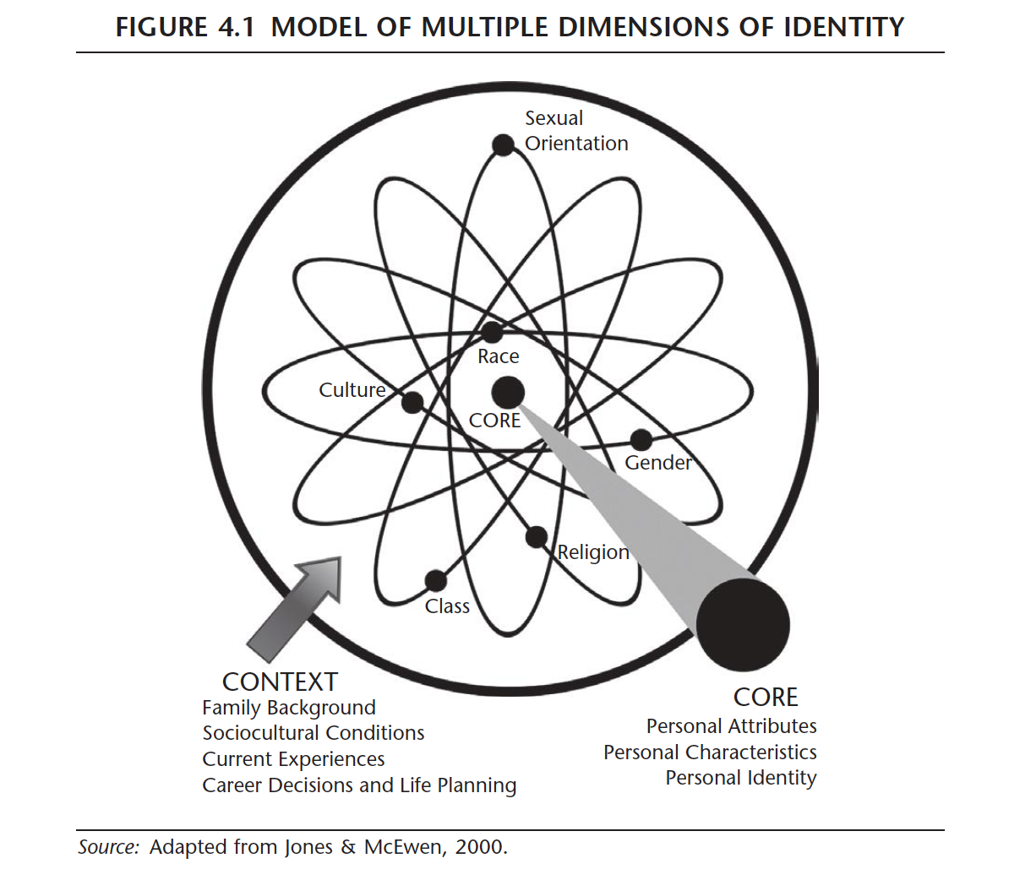
Notes:
MMDI
Core attributes
Complexity of identities
Those that are more salient are closer to your core and those that are not are further out
Understand that various identities intersect with one another therefore social identities are not always mutually exclusive
demonstrates the complexity of

Slide 34
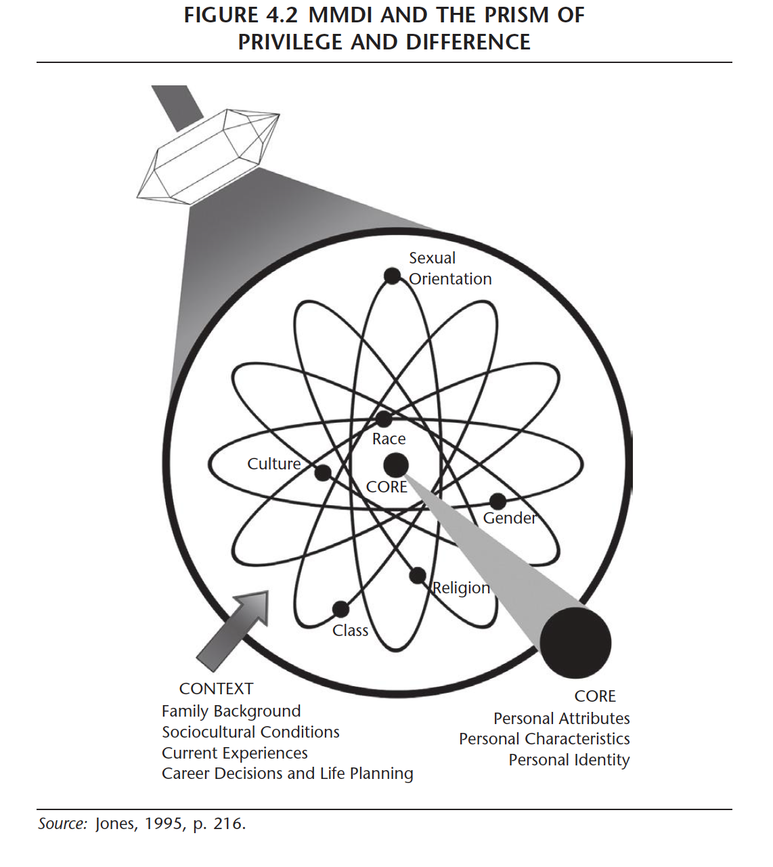
Notes:
MMDI
Prism of Privilege and Difference
Mediated the connection between participants and certain social identities and their relative salience (jones & abes 2013, pg 86)

Slide 35
Identity Development – Activity
Social Identities
– Age
Race/Ethnicity
Ability
Sexual Orientation
National Origin
Assigned Biological Sex
Gender Identity
Gender Expression
Education Level
Previous Work
Political Beliefs
Religion
Income Level
Primary Language
Family Role
Smoker vs nonsmoker
Parental status
Thinking style
Citizenship Status
Marital Statues
First Generation
Notes:
Have everyone take a few moments to write down and reflect upon their identities and look to the MMDI temple to begin to place their identities on the templet
More salient or important identities are closer to your core
Debreif
What were thoughts
Understand that this does and can shift

Slide 36
Structure for an Advising Conversation
Opening
2. Talking with the student
3. Embrace silence in the conversation
4. Admit your ignorance
5. Be honest about bad news
6. Ask questions and make referrals
7. Closing
Notes:
Role Play Activity- in pairs
Have one person be the student and the other be the advisor/CC
Go through what the individual feels is a positive/ meaningful advising meeting 5 minutes or so
*Create guided questions or subject to help individuals role play a scenario*
Have the student then provide feedback on what went well and what could be improved
Switch roles and repeat

Slide 37
Protentional points of Contact of VIH Advising
Initial Interest Meeting
Pre – Departure Meetings
CEE Advising
Summer Global Experience Meeting
Alumni Advising
Letter of Agreement
Meetings
Notes:
Explain that these are examples of moments of contact but that they will not be limited to these four moments
For example, with CEE meetings they will most likely experience multiple meetings with students
i.e. Initial CEE Idea meeting, weekly meetings leading up to CEE event, debrief meeting

Slide 38
Small Group Discussion
Break out into small groups based on the moments of points of contact that you feel you need more support or help with.
In these small groups:
Reflect upon what has been successful for you/ what has not been success
What are areas of clarification you need in regards of foundational knowledge
Example: timeline of events, where to find documents, when students need to complete documents
What are areas of improvement you would like to work towards?
Notes:
Small Group Activity –
Break out into 4-5 small group where they feel they need more development or support
Have individuals discuss the following promotes or go with what topics pop up in discussion

Slide 39
Questions? Comments?

Slide 40
Thank you!

Slide 41
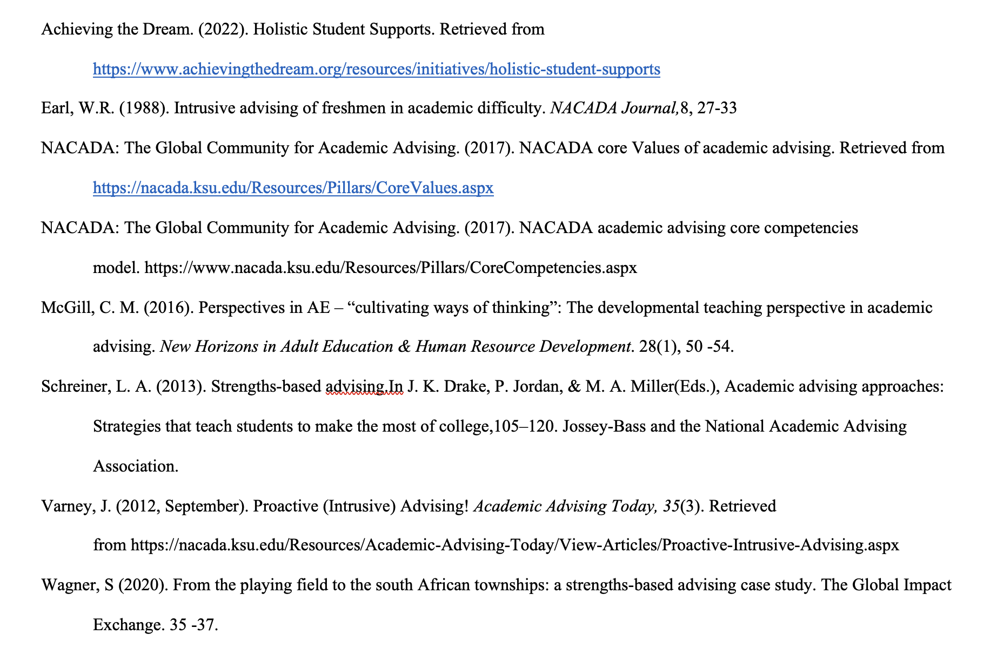
References

Slide 42
References
https://www.aclu.org/news/racial-justice/kimberle-crenshaw-on-teaching-the-truth-about-race-in-america/
Jones, S. R., & Abes, E. S. (2013). Identity development of college students : Advancing frameworks for multiple dimensions of identity. John Wiley & Sons, Incorporated.
Created from pitt-ebooks on 2022-02-07 01:02:22.
https://daily.jstor.org/what-is-critical-race-theory/

