Slide 1
Vih Mentoring Program: Making the Most of VIH

Slide 2
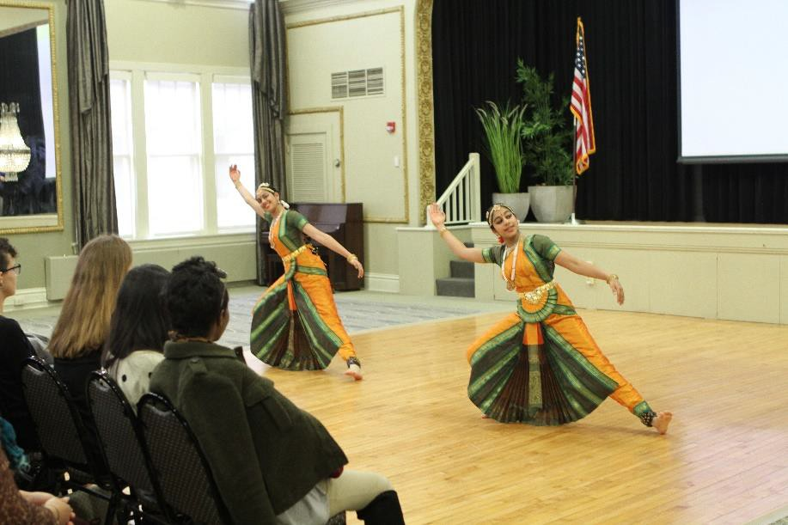
Spring Conference
What to expect
Pre-Conference assignments
What to take with you
Advice on making the most of the VIH Spring Conference curriculum
Questions?

Slide 3
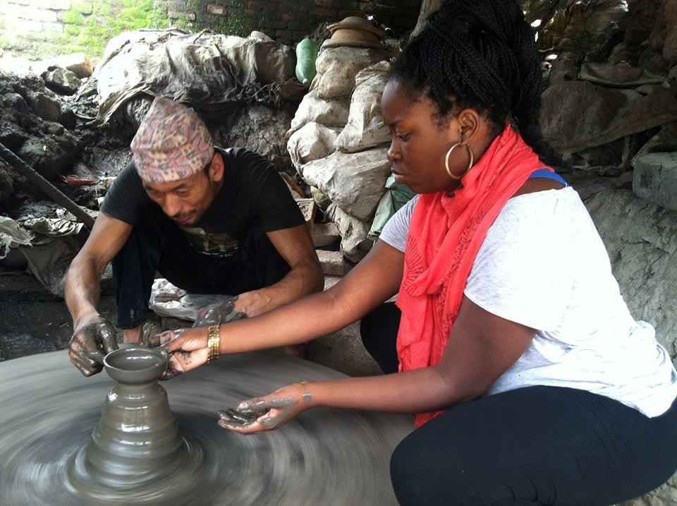
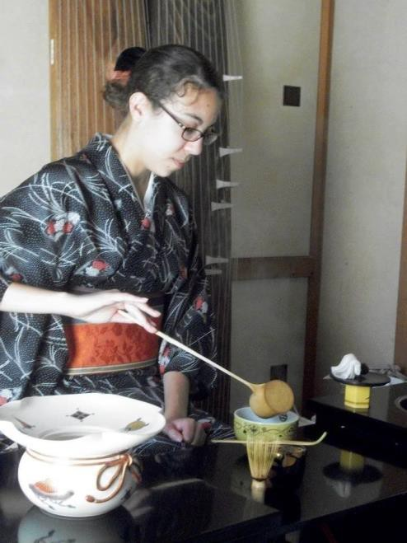
International Experience
Program provider information
Passport
Flights
Communication while abroad
Country information
Language
Dress
Customs

Slide 4
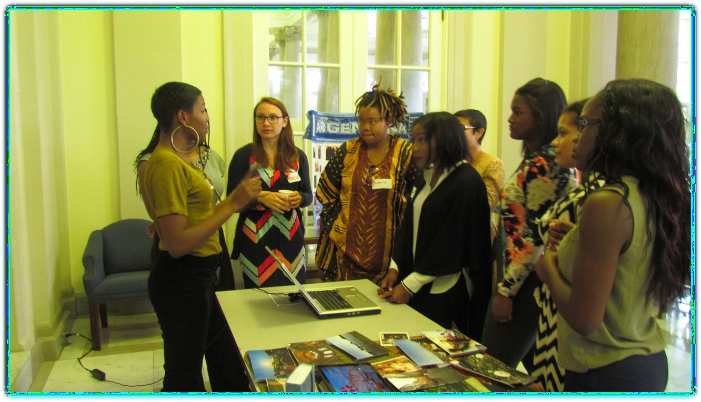
Fall Conference
What to expect
What’s different about the fall
retreat?
Pre-conference assignments
What to take with you
Advice on making the most of the VIH Fall Conference curriculum
Questions?

Slide 5
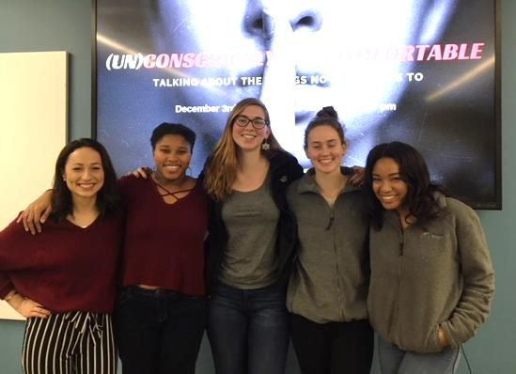
Community Engagement Experience (CEE)
The CEE serves as a way for awardees to bring their cultural learnings back to their communities and share their experiences
A group project with the other Viras
from your Institution
Mentor: Describe your CEE

Slide 6
Learning from Each Other
Mentor, please share your learnings through the VIH Program for the following:
Teamwork
Communication
Relationship Building
Confidence
Leadership

Slide 7
Remember: Everyone is nervous about the Conferences, but use them as an opportunity to meet your fellow Viras and prepare for your time abroad.

