Slide 1
VIH Program for Women & Gender Minority Global Leaders

Slide 2
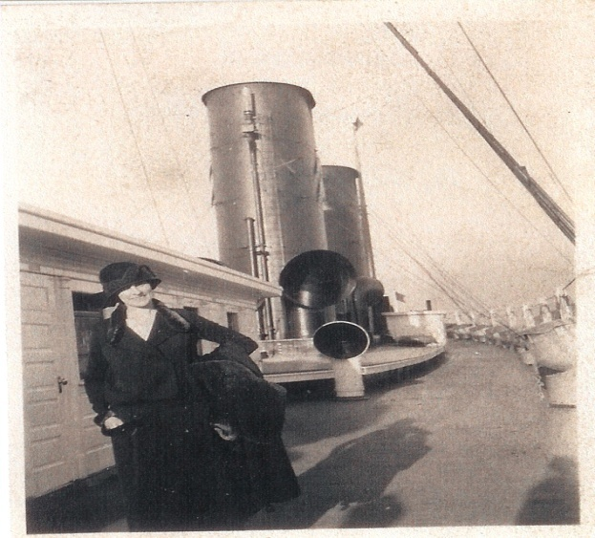
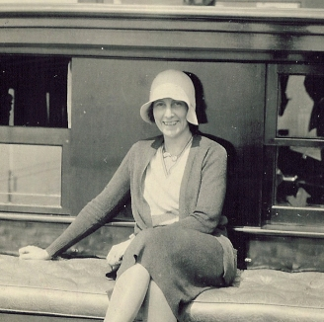
A role Model for women
The transformational impact of foreign travel
Notes:
Introduce Vira Heinz.
She was inspired by the impact of her travels through Europe
Wanted to provide others with the opportunity to study aboard
She began providing a scholarship to young women in Pittsburgh
The program has since developed and now incorporates aspects of leadership development and community engagement

Slide 3
Participating Institutions
Duquesne
Pitt-Oakland
Pitt-Bradford
Pitt-Greensburg
Pitt-Johnstown
Washington & Jefferson
Waynesburg
Lincoln
Robert Morris
Thiel
Temple
Arcadia
Chatham
Carlow
Notes:
Introduce self and connection with program and a general overview of the program
- 14 institutions across PA

Slide 4
Mission
The mission of the VIH Program is to develop and encourage a passion for life-long learning and civic engagement for first-time, women, non-binary, and transgender travelers.

Slide 5
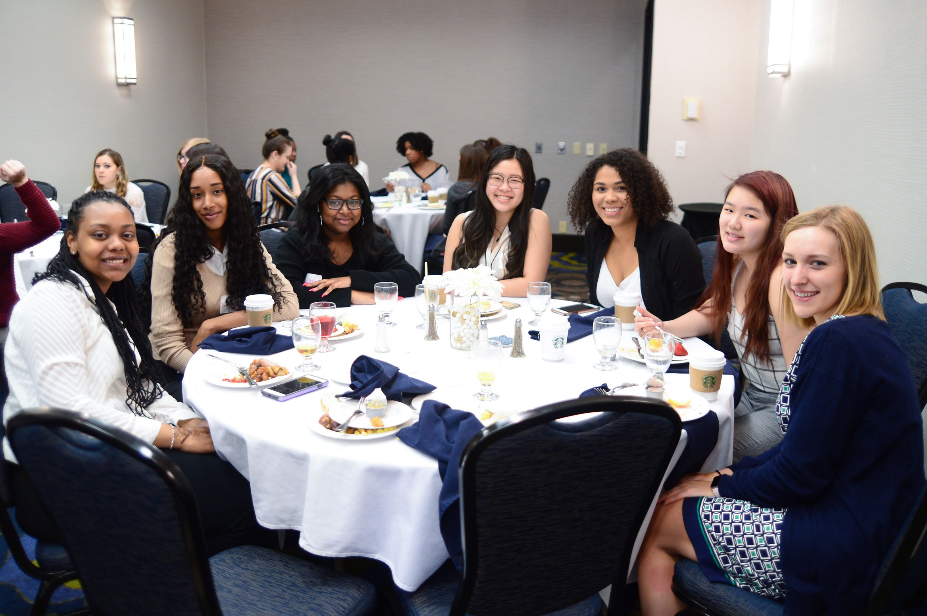
Pre-Departure Conference
Cultural Simulations
Cultural Activities
Roundtable Discussions

Slide 6
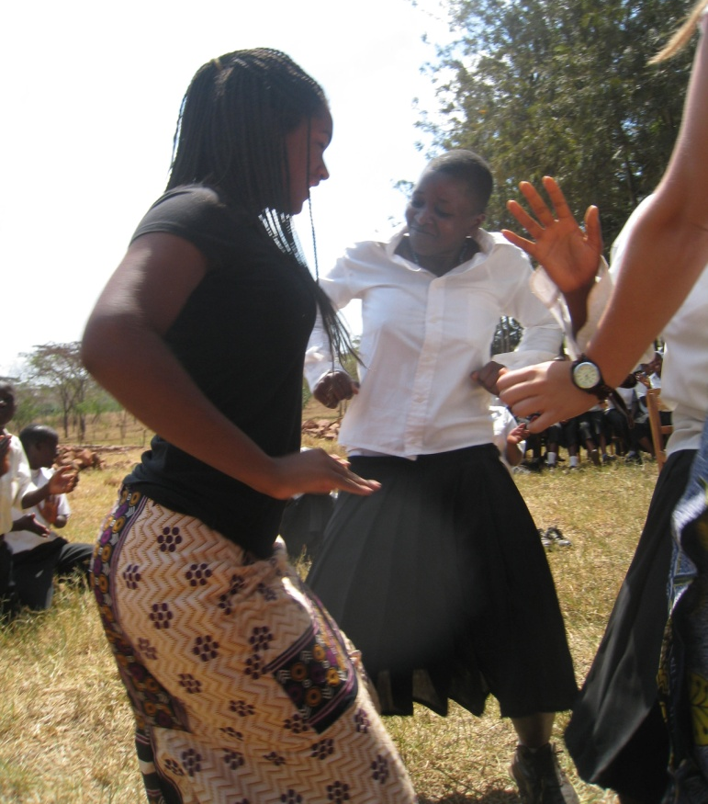
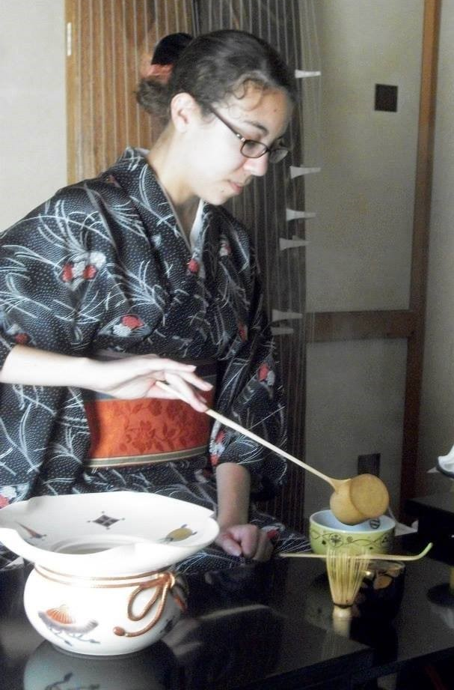
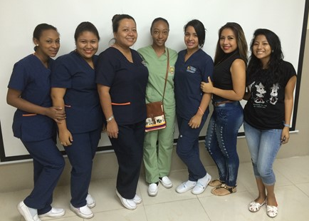
Global Experience and Experience report
Short Answer Questions
Budget
Photos

Slide 7
Leadership Development Conference
Developmental Experiences
Intersection of Gender
and Leadership
Brainstorm CEE

Slide 8
Community Engagement Experience
Think Globally: Act Locally
Vision
Teamwork
New Initiative
Notes:
Purpose and format
Opportunity to capitalize on newfound passions and knowledge they gained from international experience

Slide 9
Learning Outcomes: Fundamentals of Leadership
Learning Outcomes: Fundamentals of Leadership
Self-Knowledge
Valuing Others
Integrity
Accountability
Global Perspective

Slide 10
Application Profile
No previous international experience
Sophomore or Junior
Emphasis on increasing diversity

Slide 11
Regional Breakdown

Slide 12
Contact Information
Dr. Sarah Wagner, VIH Director
sewst29@pitt.edu
viraheinz.pitt.edu | @_vihprogram

Slide 13
Questions?
Thank you!

