Slide 1
VIH Program for Women, Non- binary, and Transgender Global Leaders

Slide 2
Participating Institutions
Duquesne
Pitt-Oakland
Pitt-Bradford
Pitt-Greensburg
Pitt-Johnstown
Washington & Jefferson
Waynesburg
Lincoln
Robert Morris
Thiel
Temple
Arcadia
Chatham
Carlow
Notes:
Introduce self and connection with program and a general overview of the program
- 14 institutions across PA

Slide 3
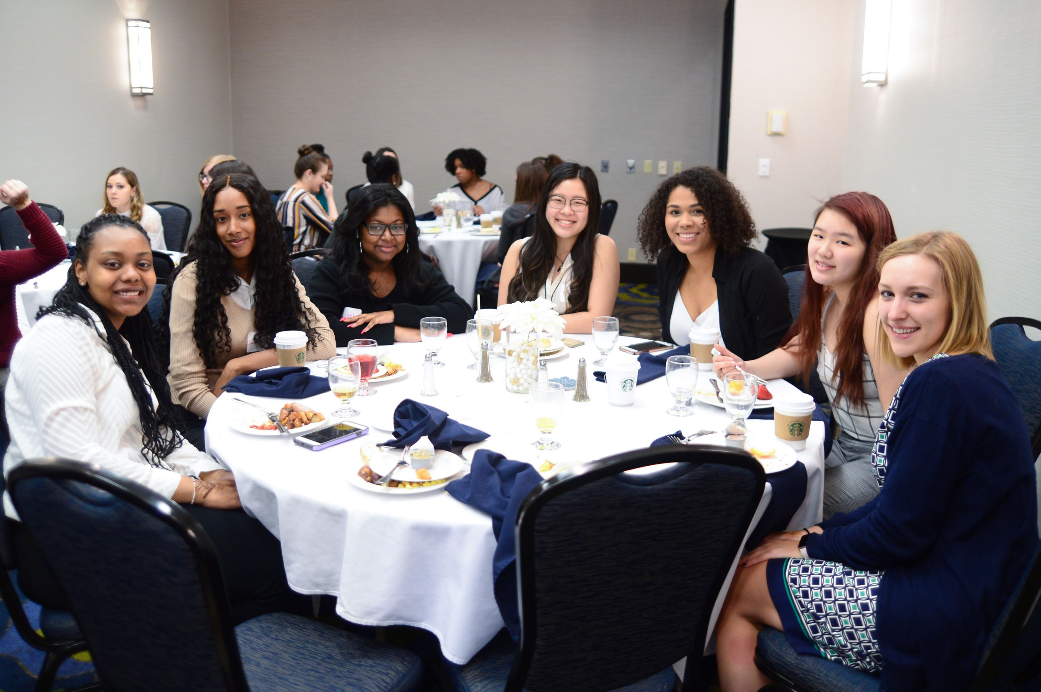
Pre-Departure Conference
Cultural Simulations
Cultural Activities
Roundtable Discussions

Slide 4
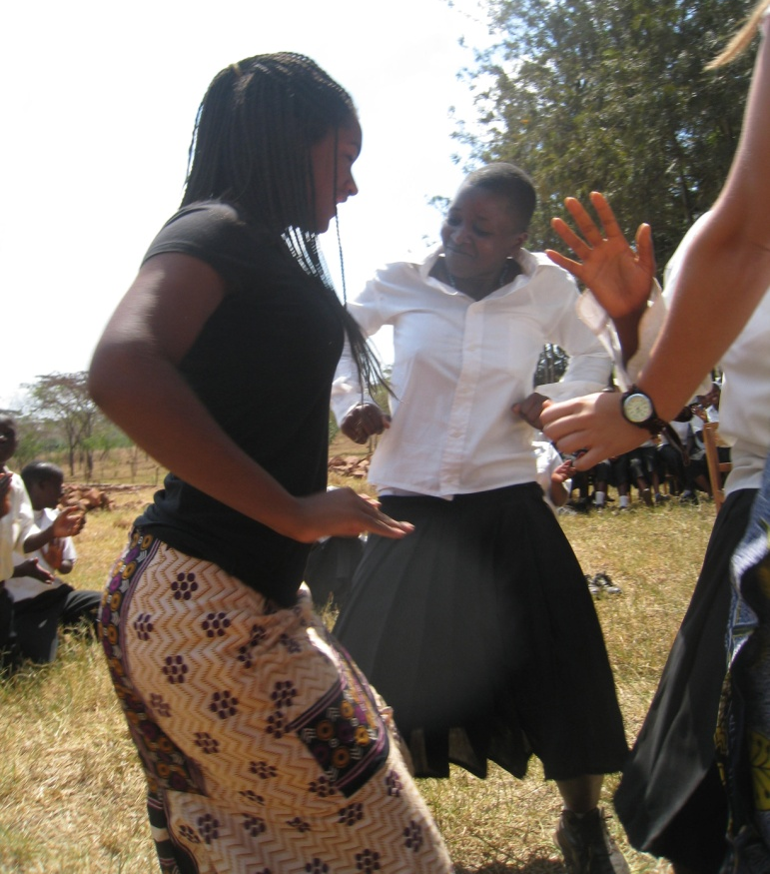
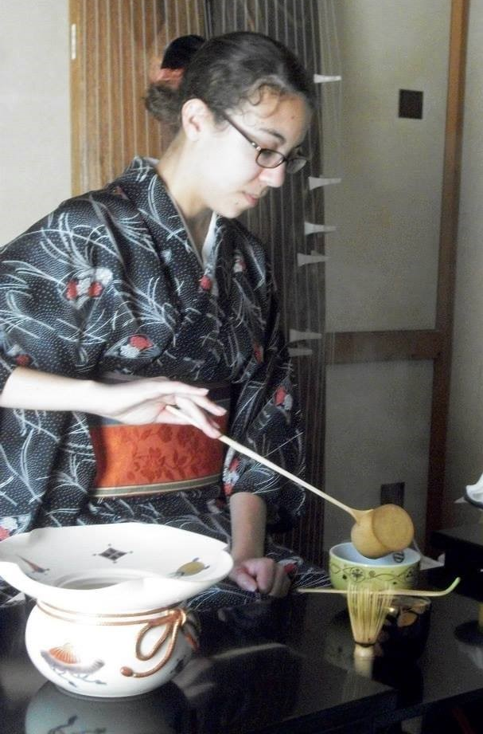
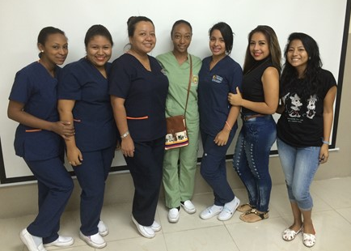
Global Experience and Experience report
Short Answer Questions
Budget
Photos
Notes:
Takes place in the summer after your sophomore or junior year
Create and experience report where you reflect upon your global experience

Slide 5
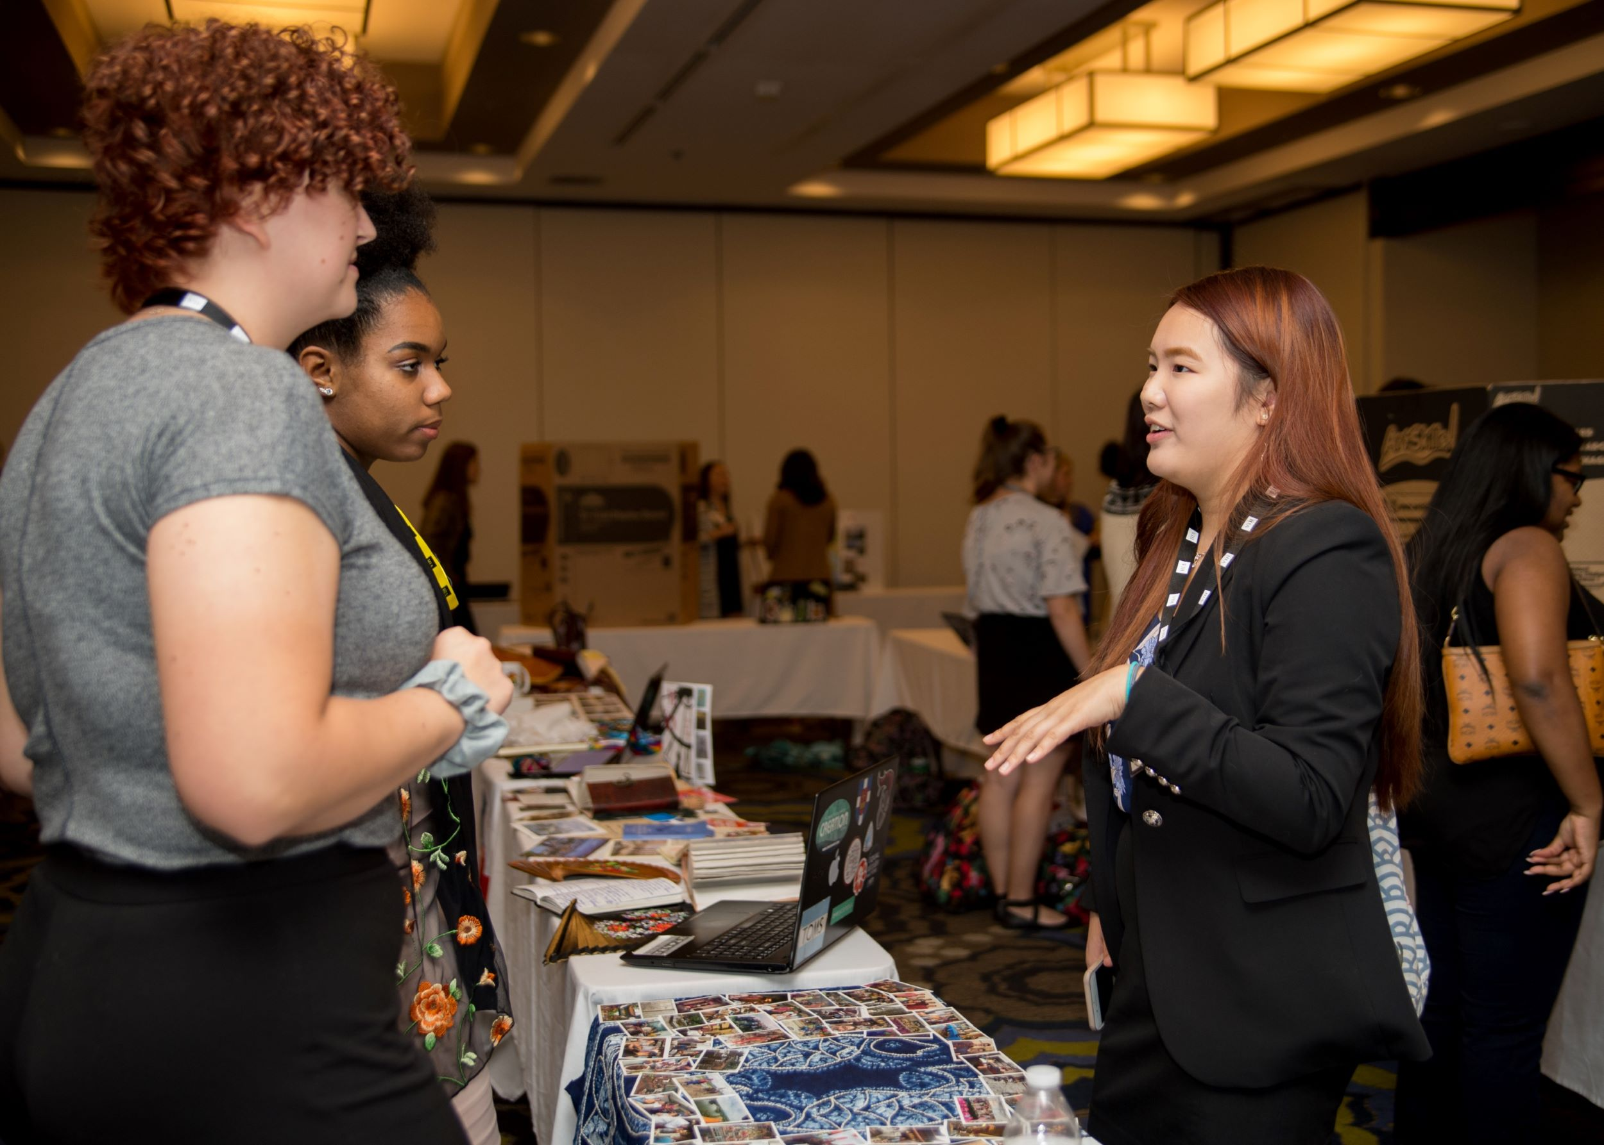
Leadership Development Conference
Developmental Experiences
Intersection of Gender
and Leadership
Brainstorm CEE
Notes:
Happens in September
Reflect and present upon global experience
Connect with you cohort and the vih community
Brainstorm for your CEE

Slide 6
Community Engagement Experience
Think Globally: Act Locally
Vision
Teamwork
New Initiative
Notes:
Purpose and format
Opportunity to capitalize on newfound passions and knowledge they gained from international experience

Slide 7
Contact Information
Dr. Sarah Wagner, VIH Director
sewst29@pitt.edu
viraheinz.pitt.edu | @_vihprogram

Slide 8
Questions?
Thank you!

