Slide 1
VIH Program for Women in Global Leadership

Slide 2
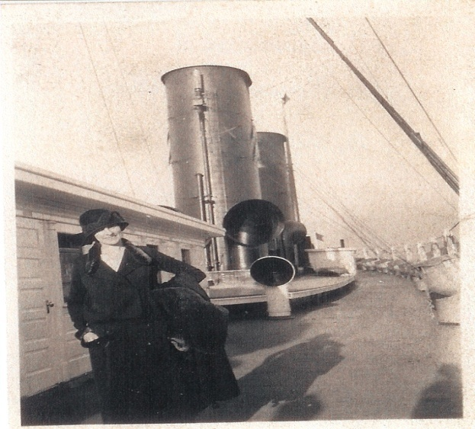
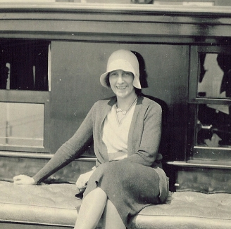
A Role Model for Women
The Transformational Impact of Foreign Travel

Slide 3
Participating Institutions
Waynesburg
Lincoln
Robert Morris
Thiel
Temple
Arcadia
Chatham
Carlow
Duquesne
Pitt-Oakland
Pitt-Bradford
Pitt-Greensburg
Pitt-Johnstown
Washington & Jefferson

Slide 4
Mission:
To develop global citizens and encourage a passion for life-long learning and civic engagement

Slide 5
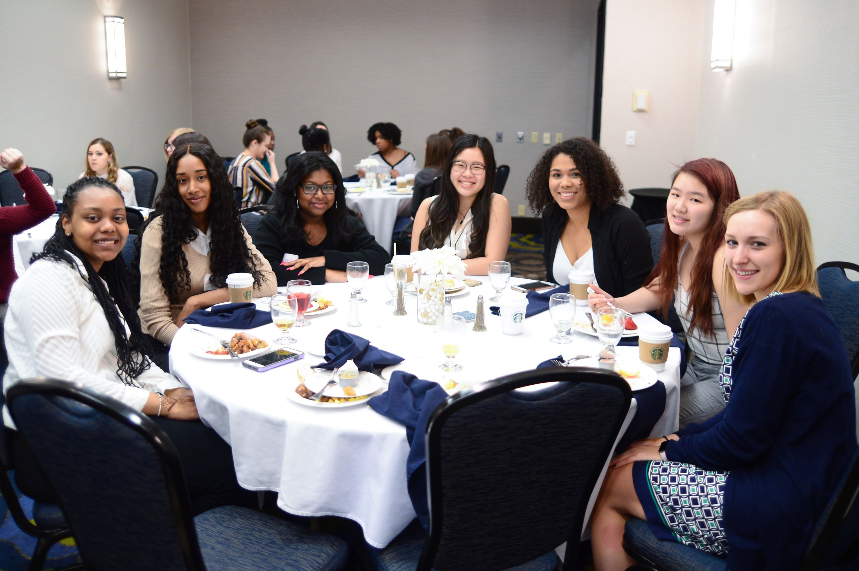
Pre-Departure Retreat
Cultural Simulations
Cultural Activities
Roundtable Discussions

Slide 6
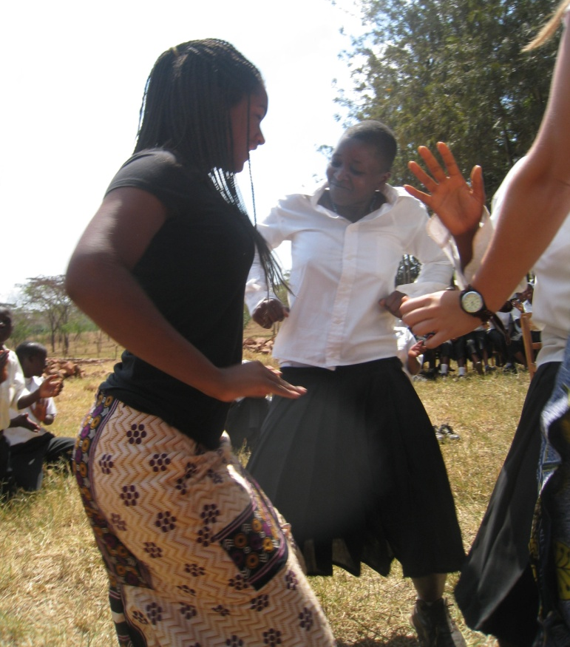
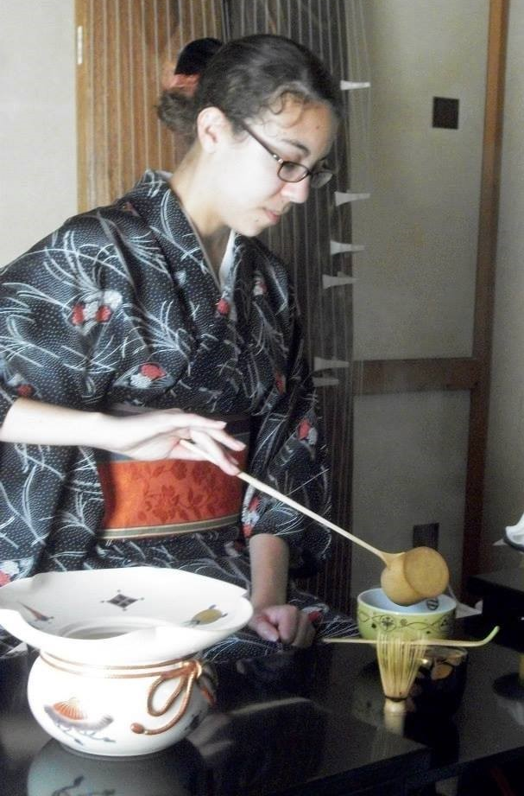
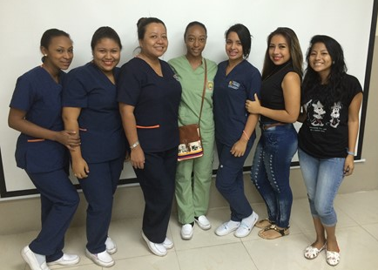
International Experience and Experience Report
Short Answer Questions
Budget
Photos

Slide 7
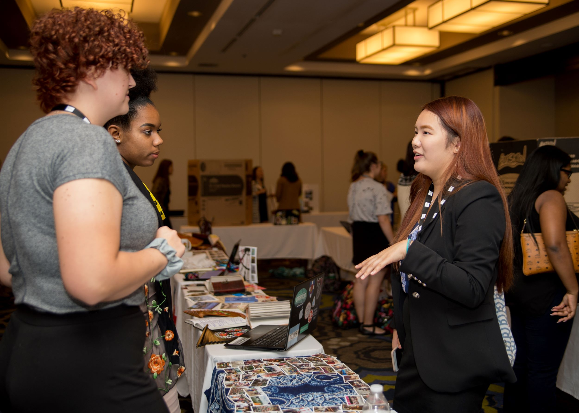
Leadership Development Retreat
Developmental Experiences
Intersection of Gender and Leadership
Brainstorm CEE

Slide 8
Community Engagement Experience
Think Globally: Act Locally
Vision
Teamwork
New Initiative

Slide 9
Learning Outcomes: Fundamentals of Leadership
Self-Knowledge
Valuing Others
Integrity
Accountability
Global Perspective

Slide 10
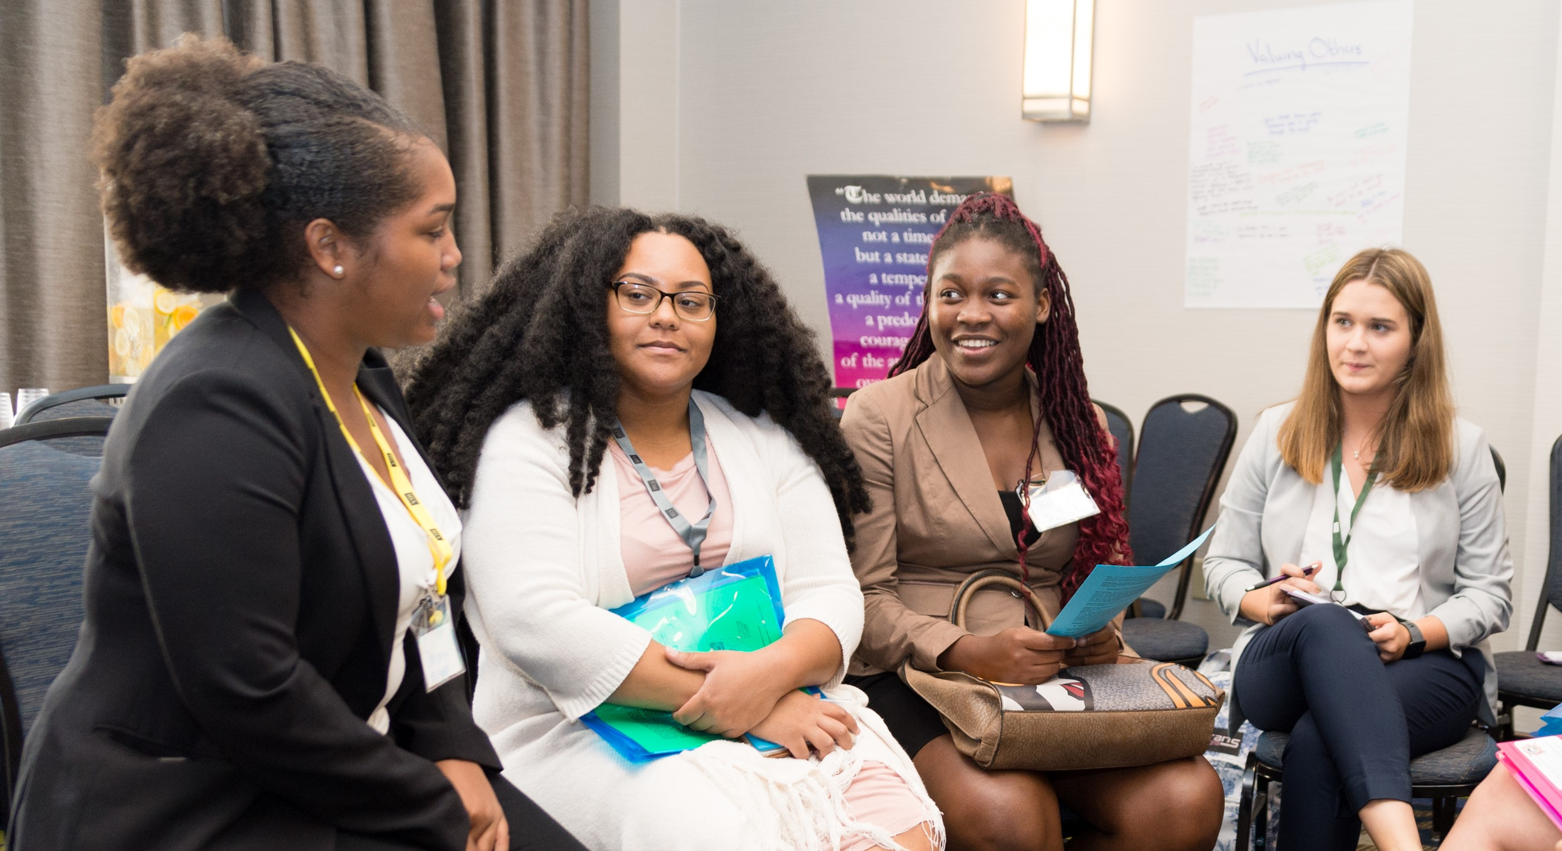
Applicant Profile
No previous international experience
Sophomore or Junior
U.S. Citizen
Emphasis on increasing diversity

Slide 11
Regional Breakdown

Slide 12
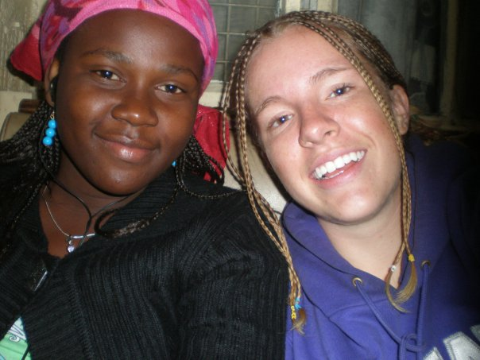
International Experience
Ruweidah
&
Jenn
“The thoughts and feelings associated with cultural immersion can be difficult to sort out without being prepared to understand these experiences… the VIH Program took me one step closer to figuring it out.”

Slide 13
Contact Information
Dr. Sarah Wagner, VIH Director
sewst29@pitt.edu
viraheinz.pitt.edu

